Slide 1
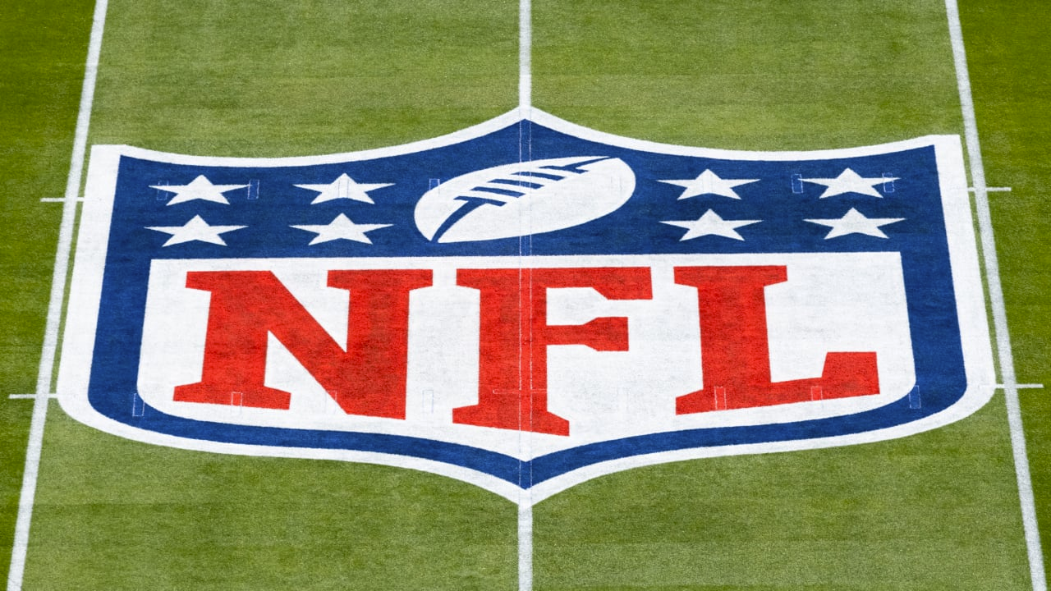
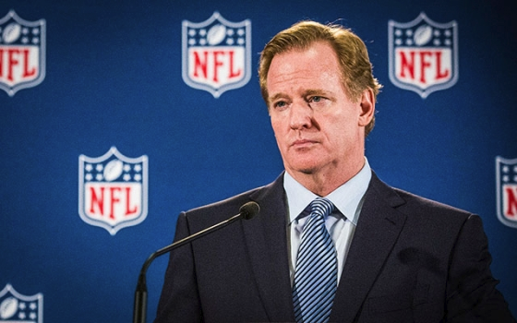
NFL Suspensions
Paul Ahn and Mohammed Al-Shalchy

Slide 2

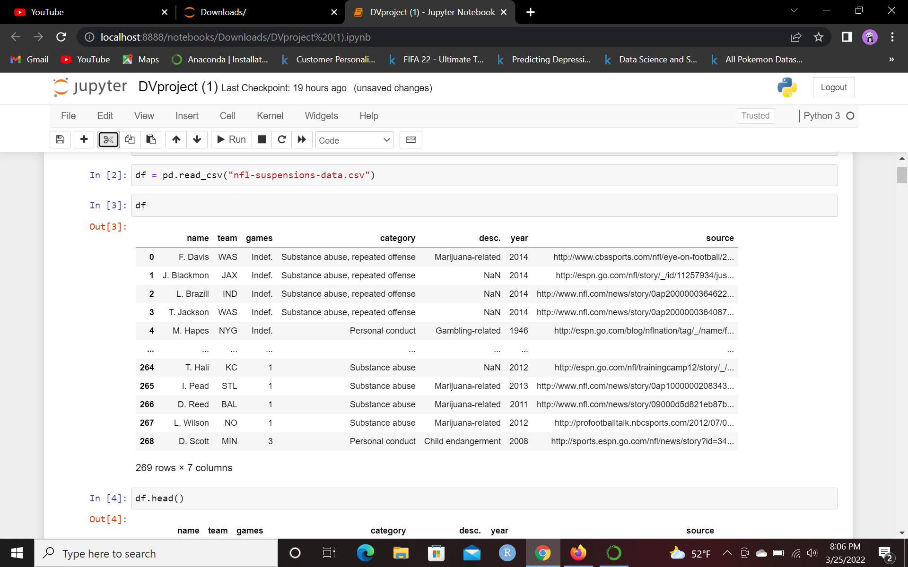
About the Dataset
269 rows by 7 columns of the history of NFL suspensions until 2014
Columns: name, team, games, category, description, year, source
Source of Data: https://github.com/fivethirtyeight/data/blob/master/nfl-suspensions/nfl-suspensions-data.csv

Slide 3

Questions We’re Uncovering
What has the rate of suspensions been in the NFL? Increasing? Decreasing?
What are the common reasons that NFL players are suspended for?
Which team has the most issued suspensions by the NFL? How many games per category of suspension?
What is the average length of each suspension category?

Slide 4
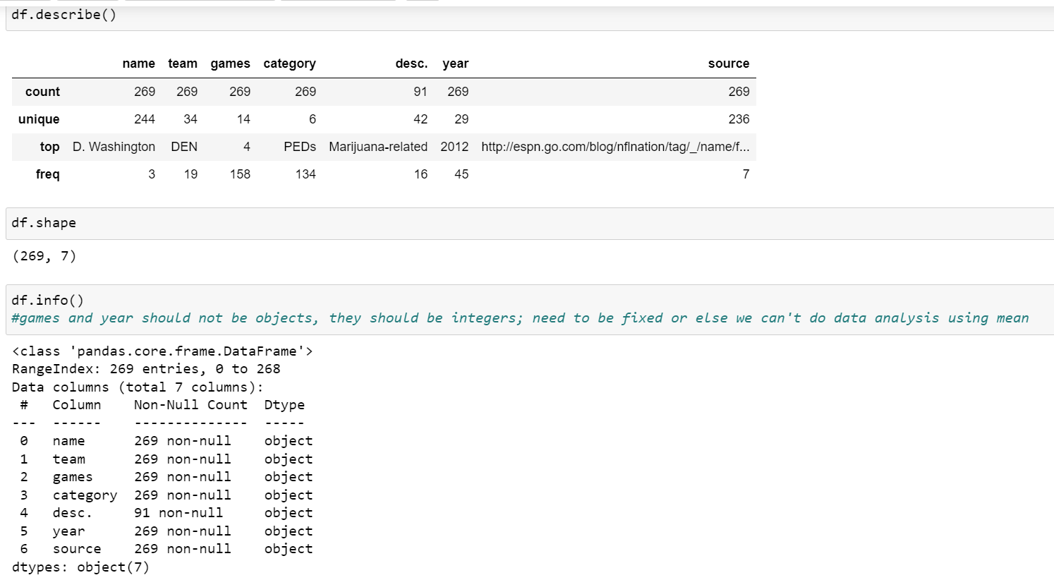
Data Cleaning(1)
All columns have values filled, except desc, which will be dropped since category communicates why a player got banned
Columns to be dropped: name, desc, and source, as we’re trying to analyze trends among all suspended players
All datatypes are object, including numeric types like year and games, which shouldn’t be data type object.

Slide 5
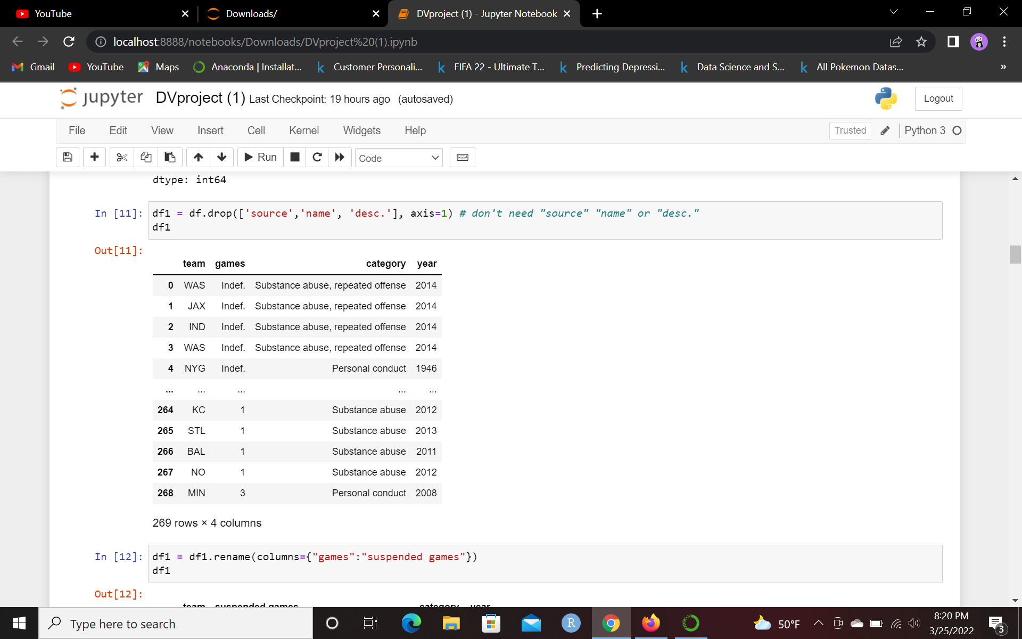
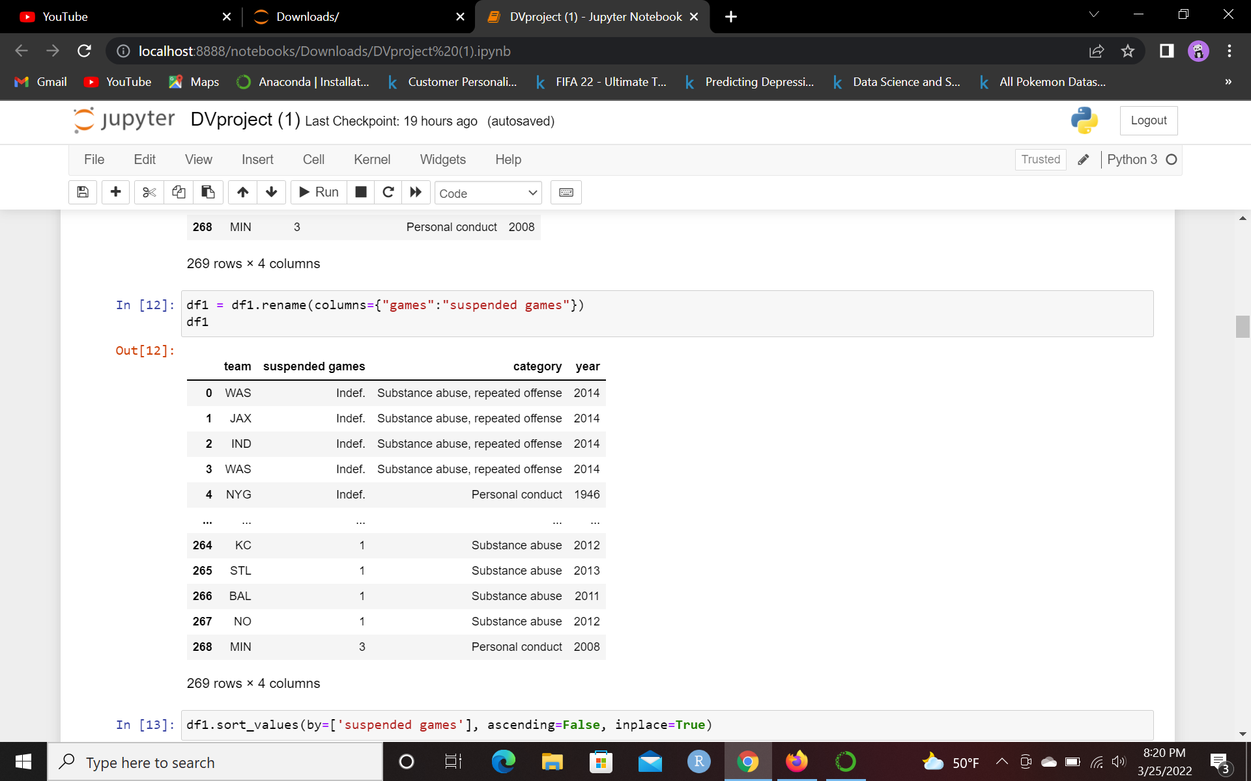
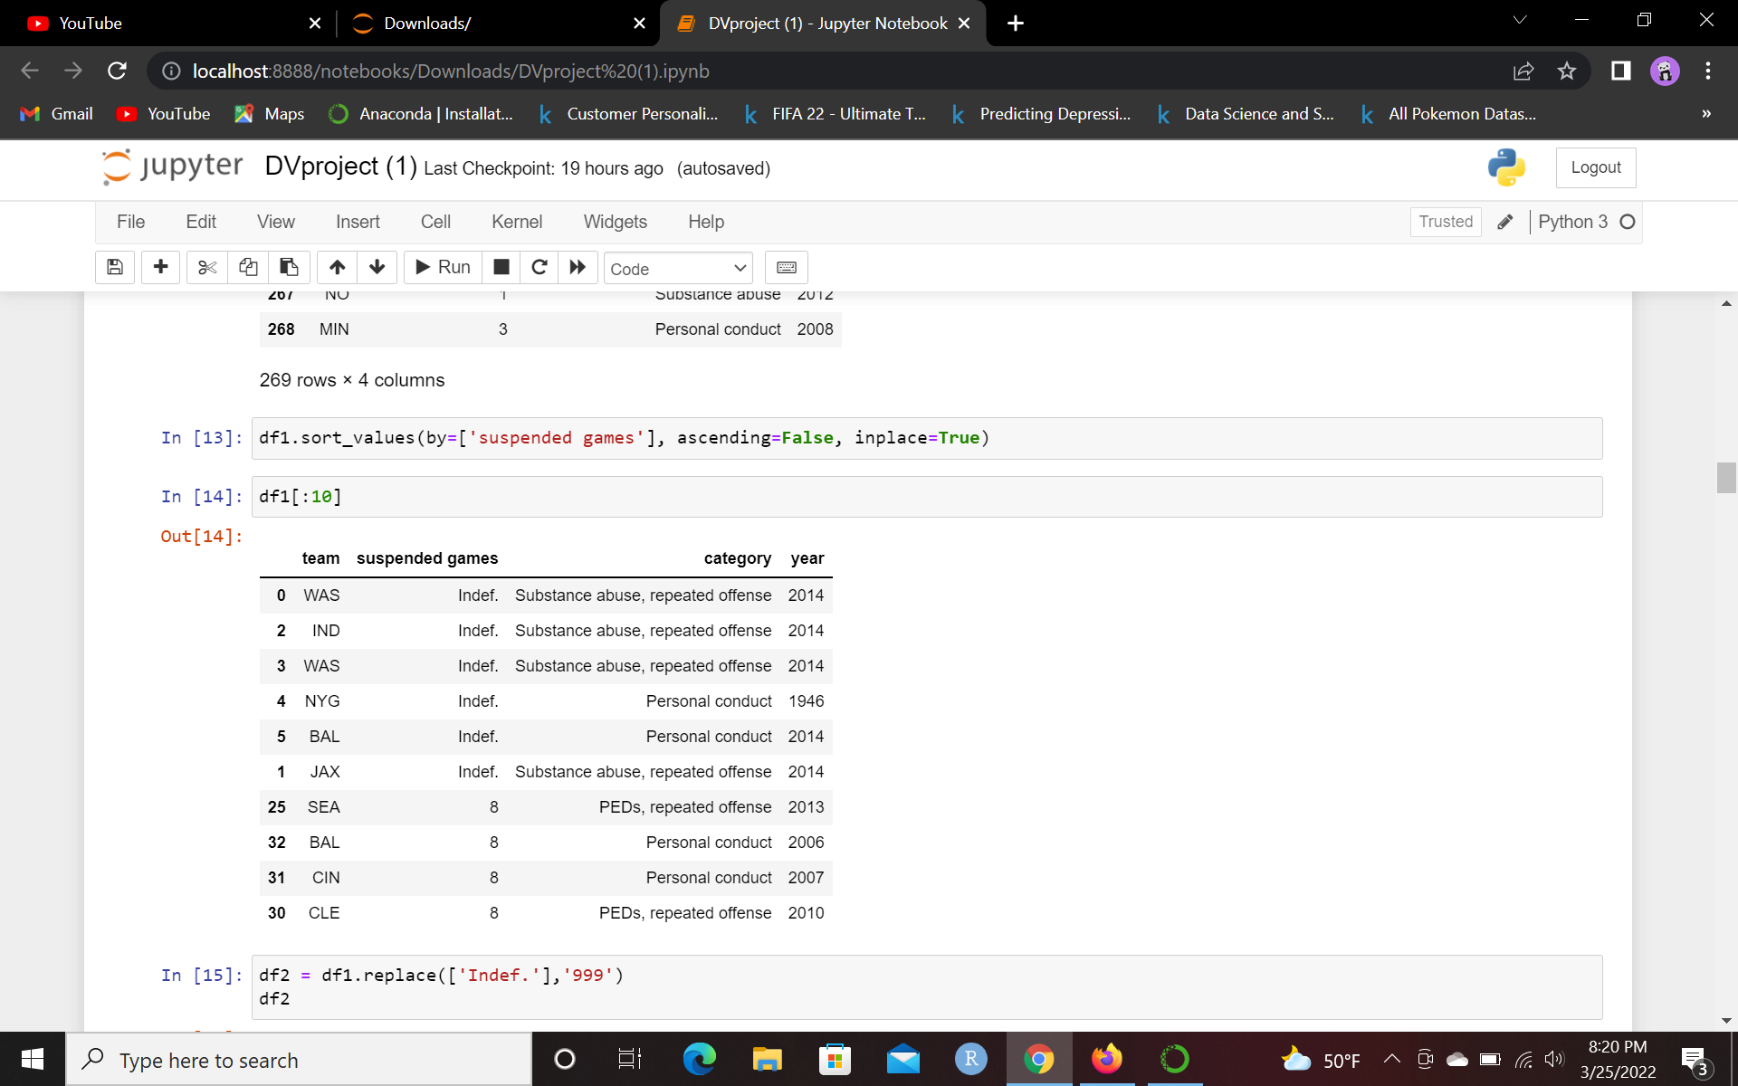
Data Cleaning(2)
Renamed “games” column to “suspended games” for specificity
Sorted values by the amount of games suspended
Replaced “Indef” suspensions with the number 999 rather than drop them

Slide 6
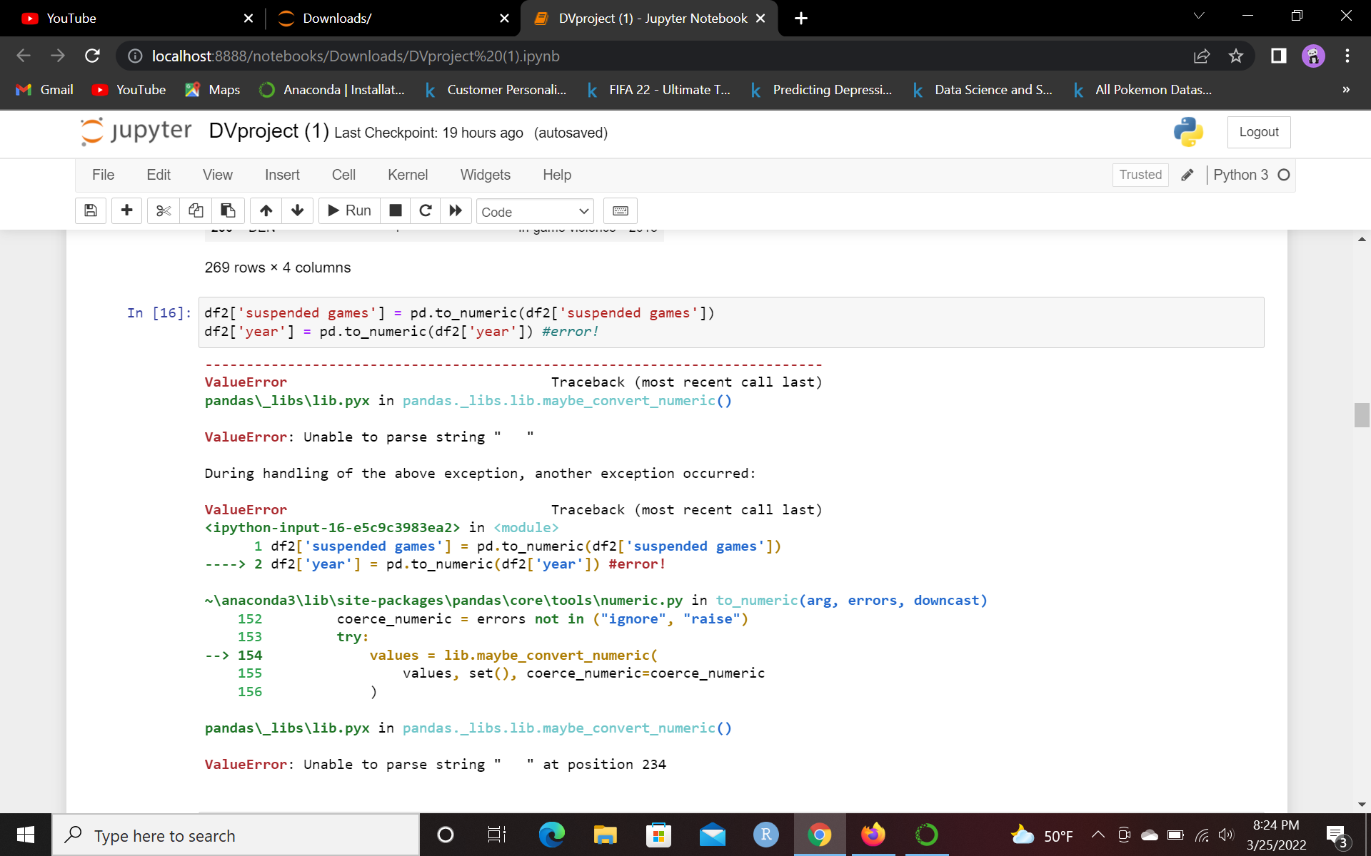
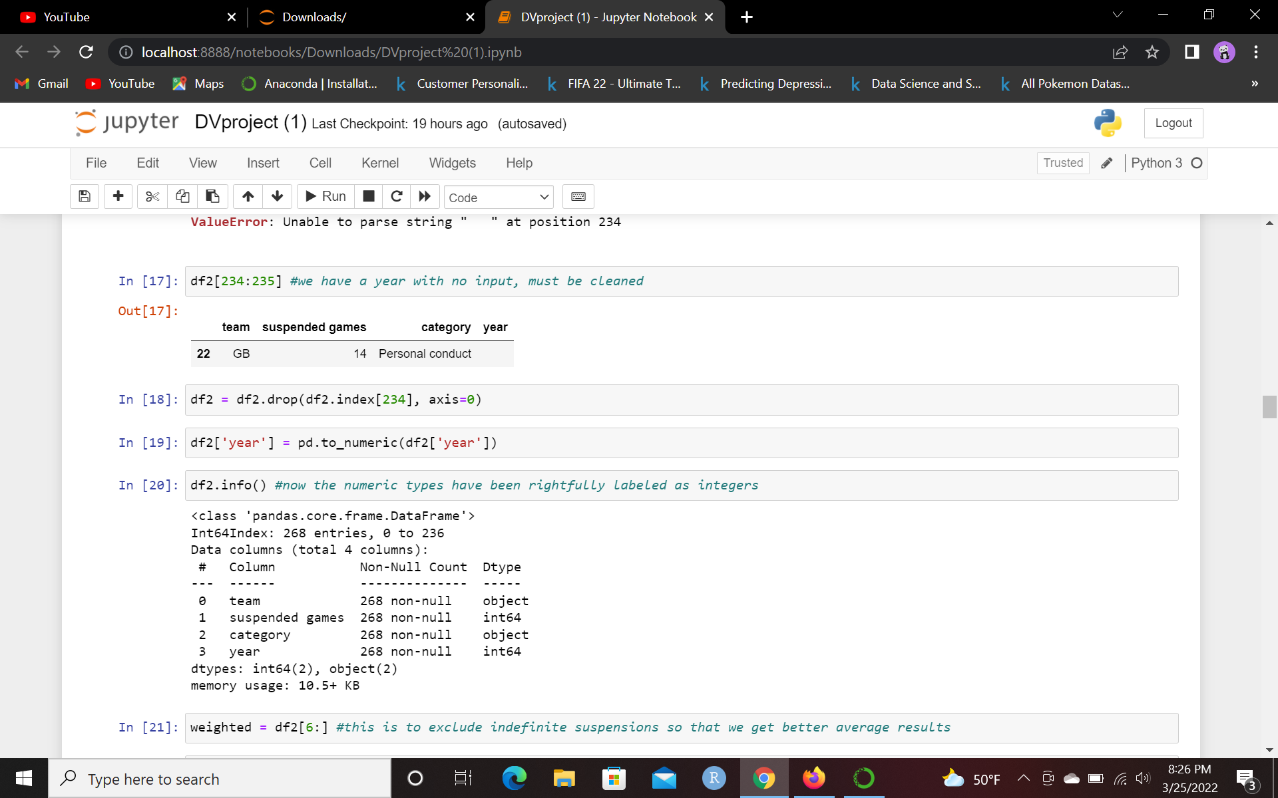
Data Cleaning(3)
Tried setting suspended games and year to numeric, but got an error with year.
Turns out that a certain index had no year input, so it was dropped
Data has been properly cleaned

Slide 7
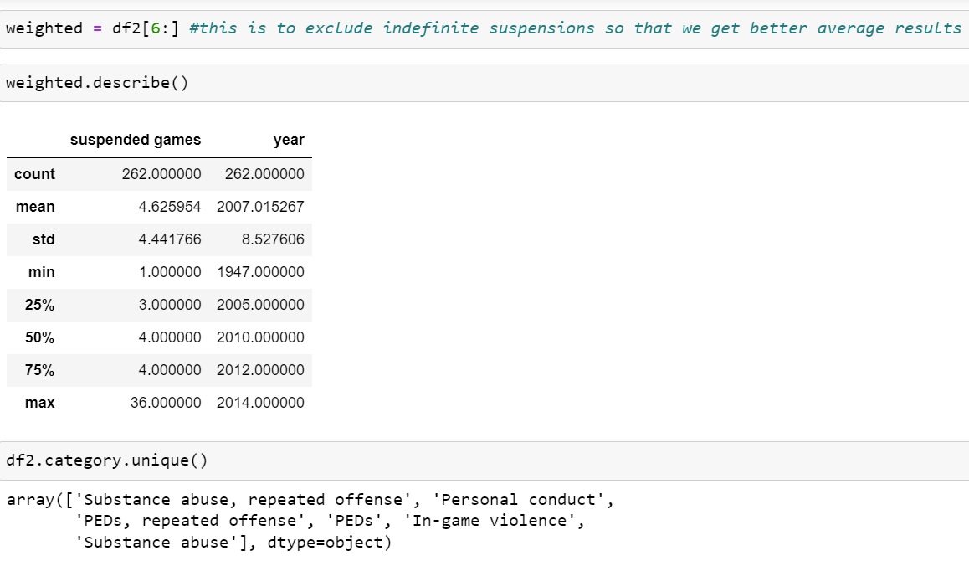
Digging Deeper
Created a weighted data frame which excludes the indefinite suspensions so that mean statistics aren’t weighted
Used .unique() to find all of the different types of suspensions: “substance abuse repeated offense”, “personal conduct”, “PEDs”, “repeated offense PEDs”, “in-game violence”, and “substance abuse”

Slide 8
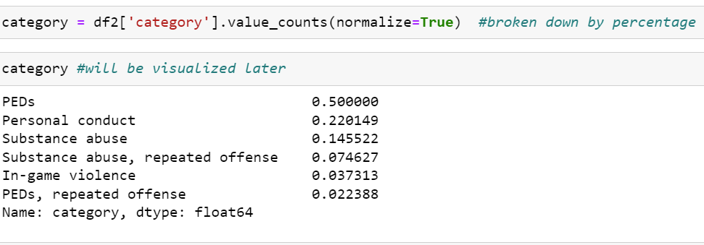
Percentage of Suspensions
Up to 2014, over 50% of NFL suspensions have been due to PEDs, with personal misconduct coming in second at 22% and substance abuse coming third at 14%.
Will be visualized later

Slide 9
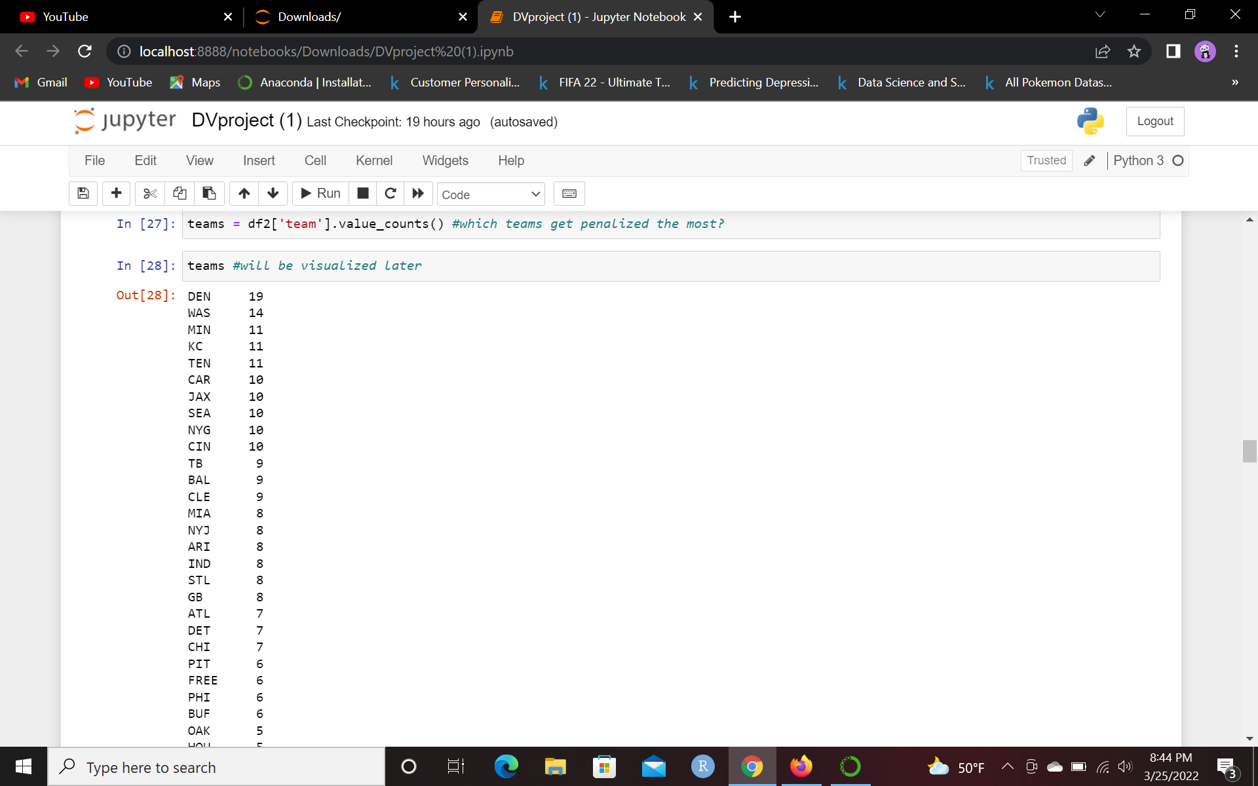
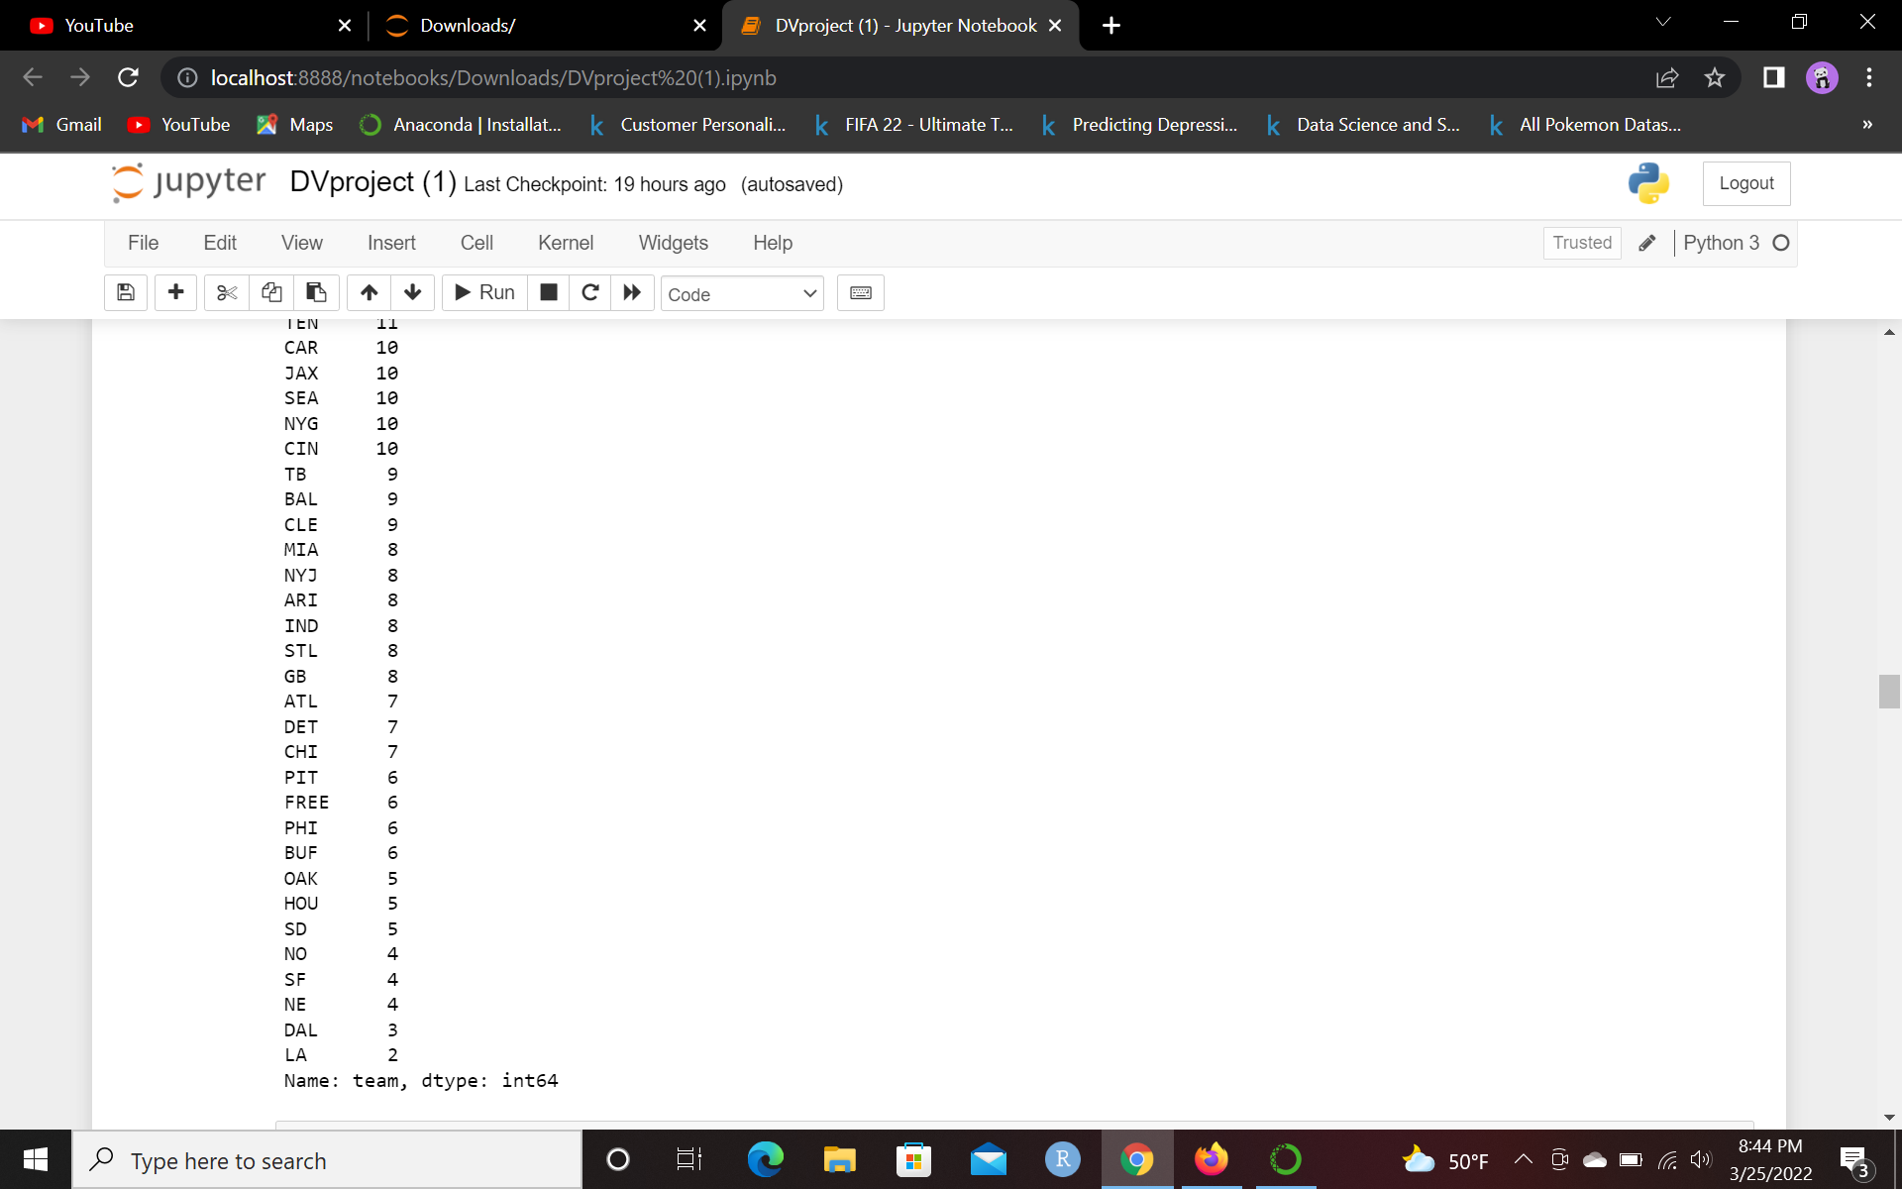
Teams with Most NFL Suspensions
Denver Broncos lead the top, of NFL suspensions throughout history, followed by Washington Commanders, and a plethora of teams
Free agents accounted for 6 suspensions throughout NFL history
Least amount of suspended teams are the LA Rams (before moving to St. Louis and then back to LA), New England Patriots, and the Dallas Cowboys
If you combine results of LA Rams and St. Louis Rams, they wind up with 10 suspensions!

Slide 10
Data Wrangling and Data Aggregation

Slide 11
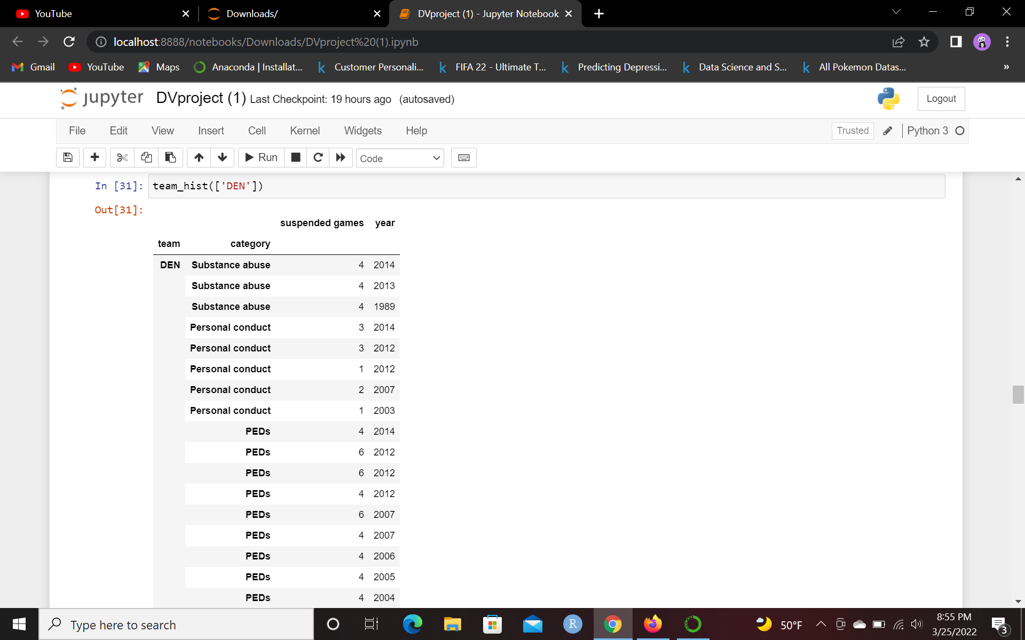
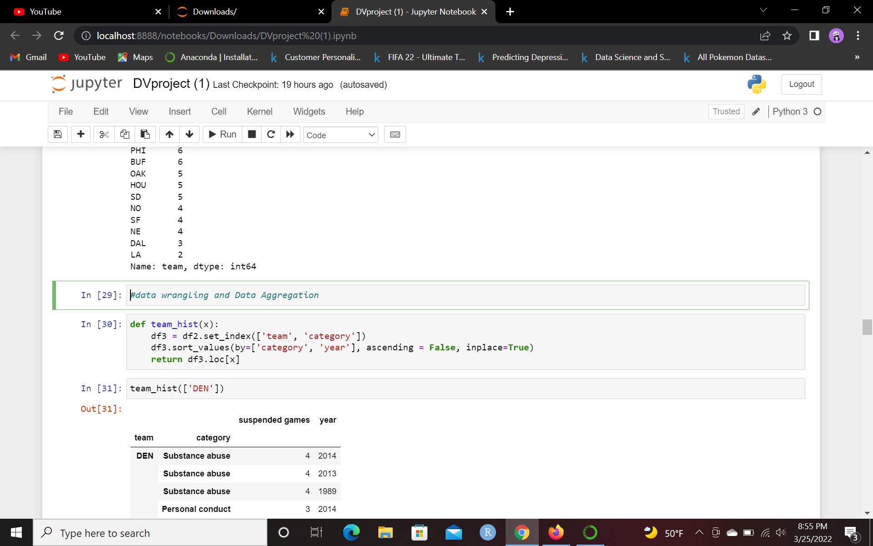
Team History
Wrote a function that uncovers the category of suspension, games suspended, and year of suspension for a given team. It is indexed by team and category and sorted by category and year

Slide 12
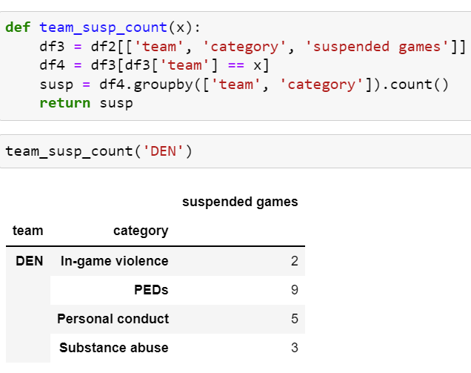
Team Suspension Count
The last function allowed us to observe individual suspensions of teams. This one allows us to observe total count of each category of suspension handed to team

Slide 13
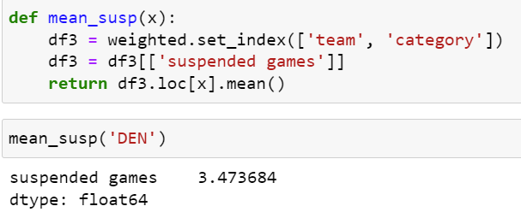
Mean of Each Individual Team Suspension
Finding average number of suspended games given to players of individual teams

Slide 14
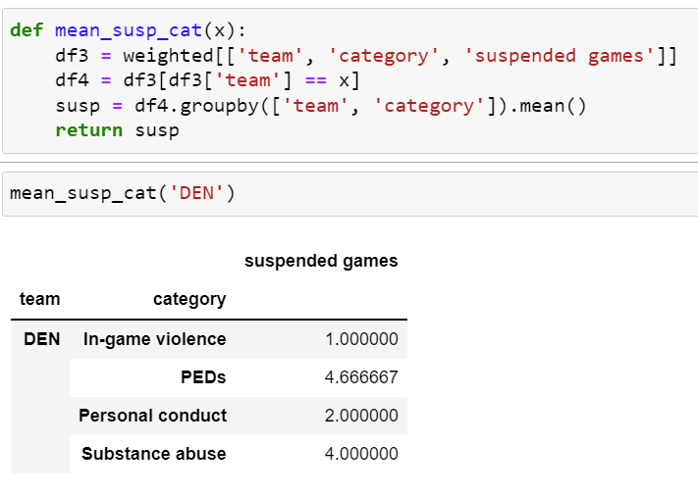
Mean of Each Individual Team Suspension by Category
Finding average number of suspended games given to players of individual teams by category of suspension

Slide 15
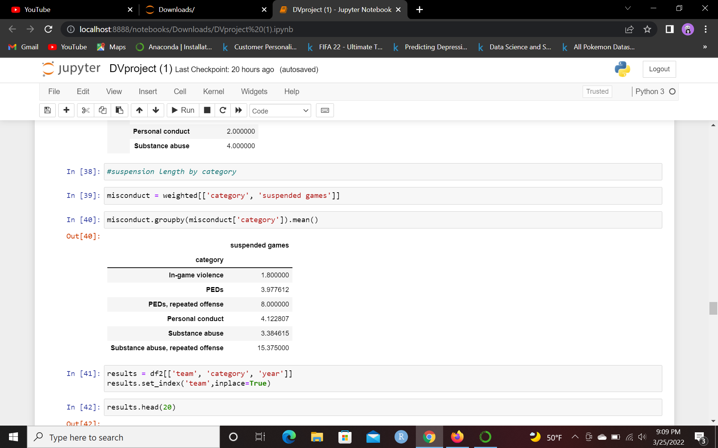
Average Suspension Length by Category
Grouping by category and getting average suspension length by category
PEDs suspensions and personal conduct suspensions are similar; it can be argued that personal misconduct suspensions should be longer
A repeated offense of substance abuse will net the largest number of suspended games by far, almost double that of a repeated offense of PEDs.
In-game violence also seems low compared to other categories

Slide 16
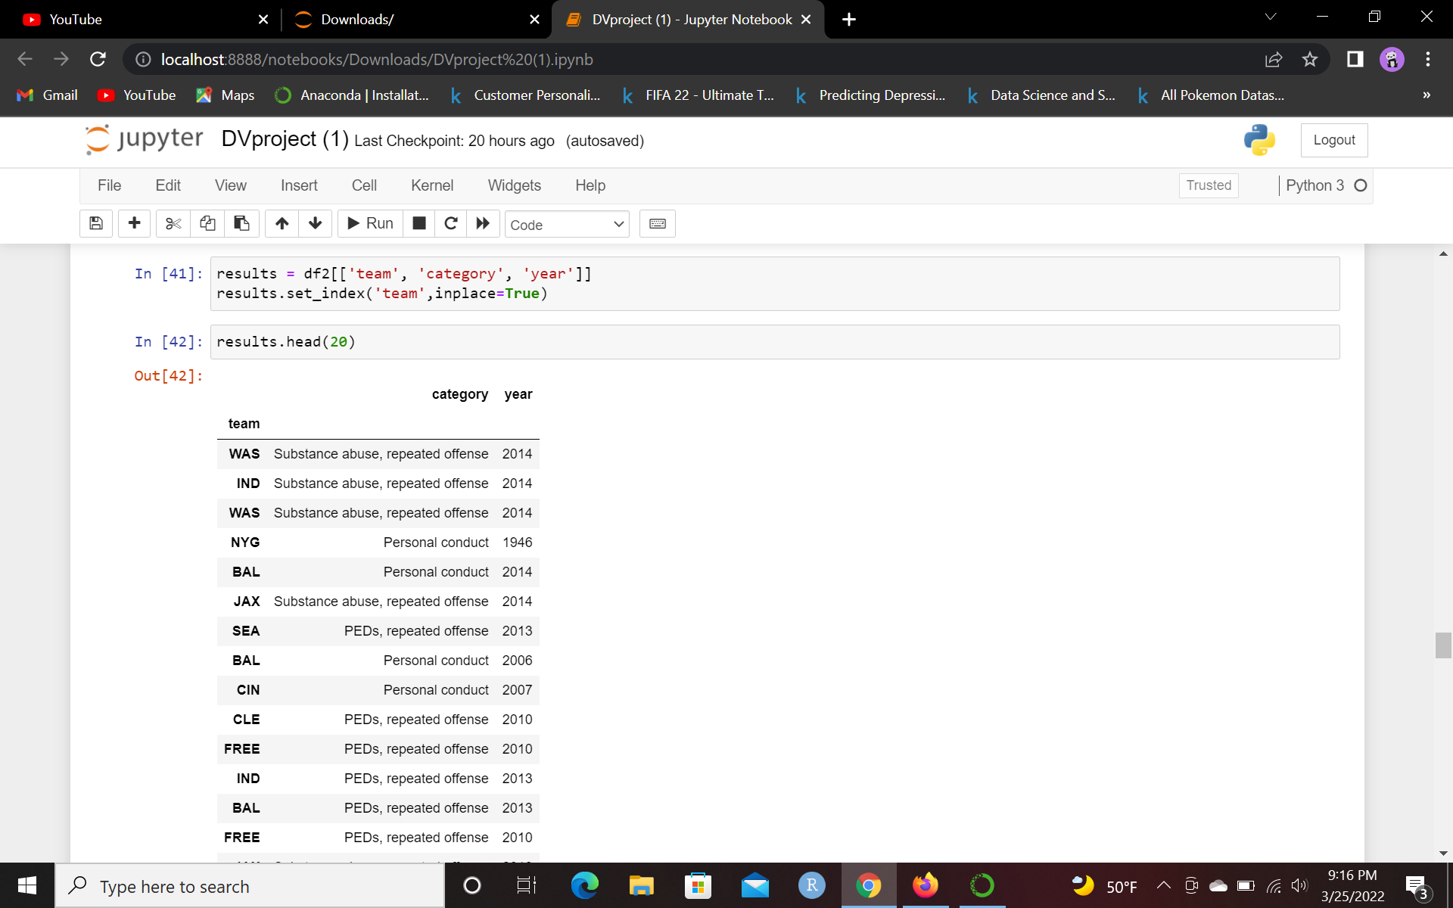
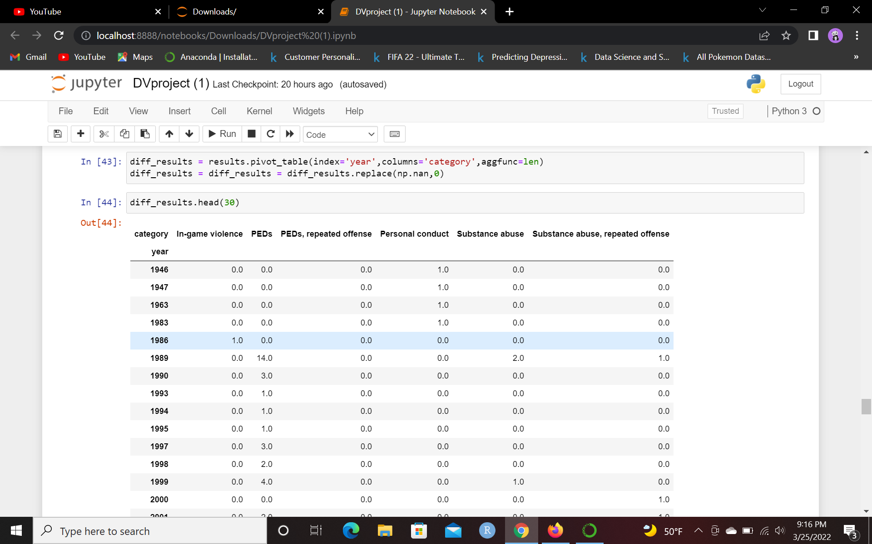
Preparation for Data Visualization

Slide 17
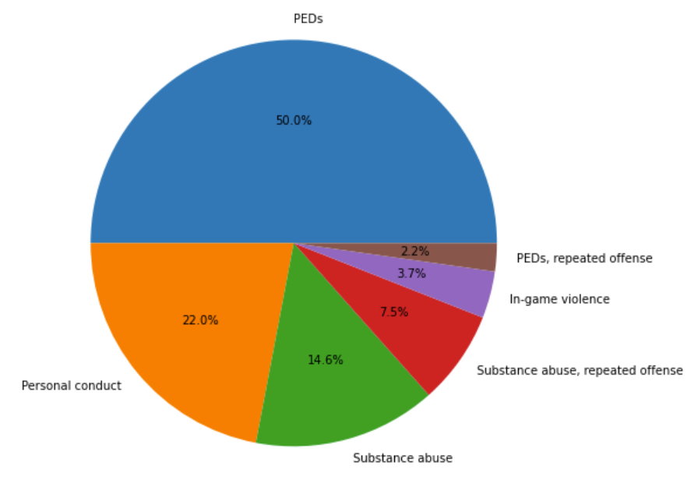
Pie Chart: Percentage of Suspension
What are the top reasons that NFL players are suspended?
Marks: areas
Channels: color, tilt, area
How it answers question:
Shows in an easy to digest visualization of the most common suspension reason

Slide 18
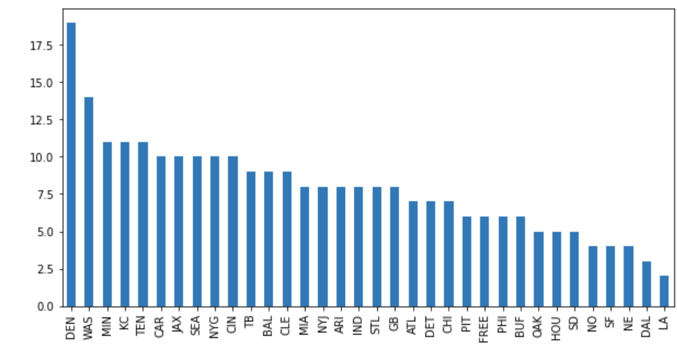
Bar Plot: Teams with Most Suspensions
Which teams has the most players suspended?
Marks: lines
Channels: 1 spatial region per mark, length to express quant value, ordered
How it answers question:
Shows a bar graph of all 34 team suspensions (including free agents and the former LA Rams) and shows the stark difference in suspensions of some teams

Slide 19
Stacked Bar Chart: history of suspensions throughout years
Is the trend of suspensions increasing or decreasing?
Marks: vertical stack of line marks
Channels: length, color hue, 1 spatial region per mark
How it answers question:
Shows a stacked bar chart of NFL suspensions throughout the years. You see that suspensions are increasing and which categories are blowing up

Slide 20
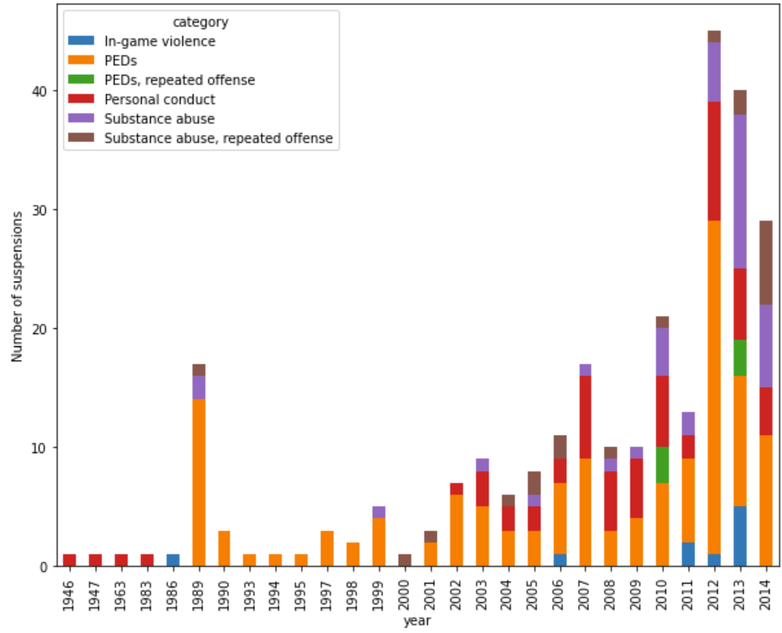

Slide 21
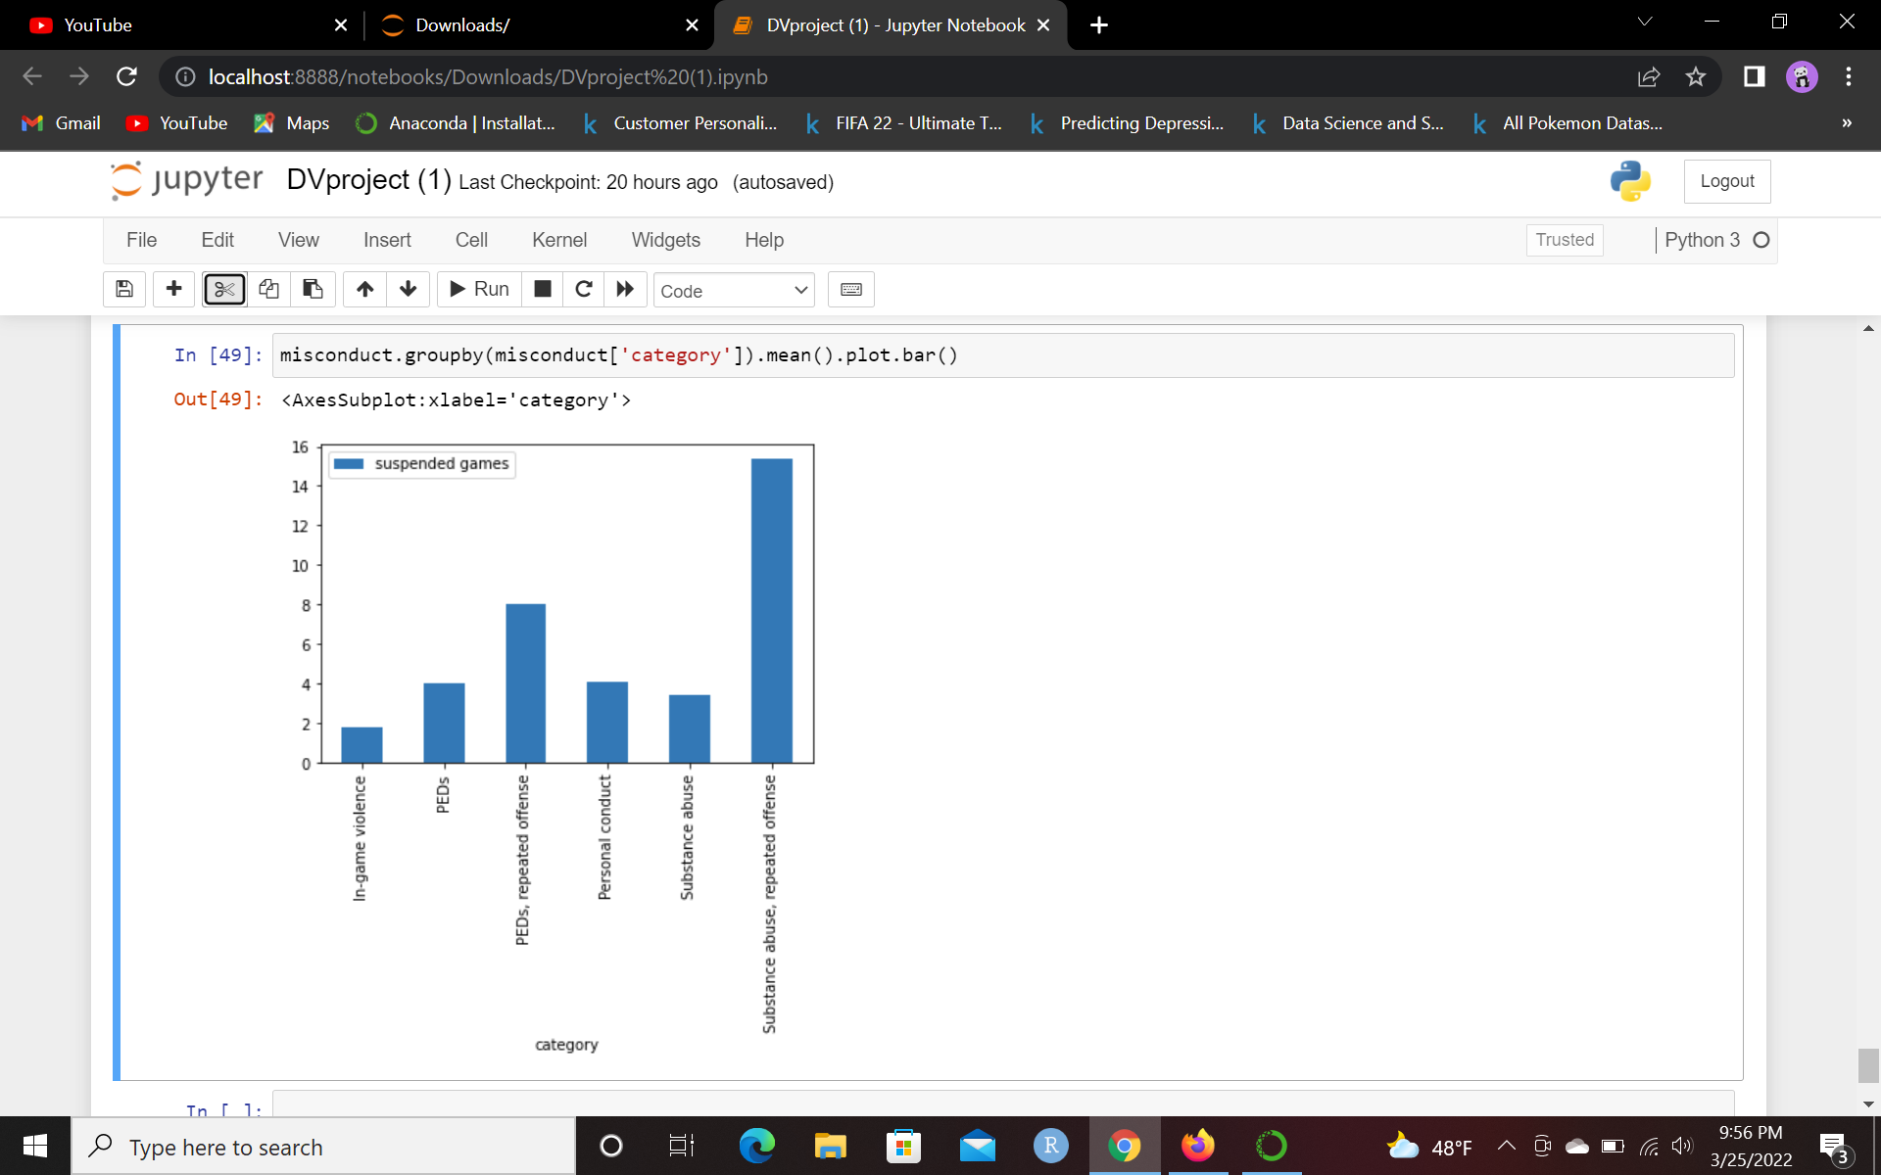
Bar Chart: Average Suspension Length by Category
What are the average amount of suspended games based on punishment?
Marks: lines
Channels: 1 spatial region per mark, length to express quant value, ordered
How it answers question:
Shows a bar graph of the average amount of games suspended by punishment category

Slide 22
Conclusion
Half of NFL suspensions up to 2014 were due to PED use.
The teams that leads with the most suspended players are the Denver Broncos and Washington Commanders by a longshot
The total amount of suspensions has been substantially increasing throughout the years, especially by PEDs and personal misconduct
The average suspension for a player that uses PEDs and personal misconduct are eerily similar. In-game violence leads to the least amount of suspensions, while the largest amount of suspensions come from repeated offenses of PEDs and substance abuse

